Slide 1

Compiler Design
Capstone Project
N. Baby Keerthi Reddy
V. Pavithra
K. Harshitha

Slide 2
Building a compiler for a concurrent programming language…

Slide 3

Introduction……
Compiler:
A compiler is a translating program that translates the instructions of a high-level language to a machine-level language. A program which is input to the compiler is called a Source program. This program is now converted to a machine-level language by a compiler known as the Object code.
Phases of Compiler:
Lexical Analysis
Syntax Analysis
Semantic Analysis
Intermediate Code Generator
Code Optimizer
Code Generator

Slide 4
Concurrent Programming Language:
A concurrent programming language, in compiler design, facilitates the simultaneous execution of tasks, harnessing parallelism for improved performance. It employs structured concurrency models, synchronization mechanisms, and specific memory models to handle simultaneous operations, while compilers optimize code for efficient parallel execution. Some languages extend capabilities to distributed computing, and accompanying debugging tools assist in identifying and resolving issues related to parallel execution, ensuring reliable and scalable concurrent programs.
Concurrency Models
Synchronization Mechanisms
Parallel Execution Optimizations
Distributed Computing
Fault Tolerance
Debugging and Profiling Tools
Language Features
Dynamic Load Balancing
Task Coordination
Scalability
new Thread(() ->
computation A()).
start();
new Thread(() ->
computation B()).
start();
Computation A() & computation B() can run in any order once they start their execution

Slide 5
Description of the project:
In the landscape of modern computing, the demand for concurrent programming languages has surged exponentially.
However, designing and implementing a compiler for a concurrent programming language presents a myriad of challenges, ranging from handling synchronization mechanisms to optimizing performance in a concurrent execution environment.
In essence, this project embarks on a journey to unlock the full potential of concurrent programming through the lens of compiler construction.
This project aims to delve into the intricate domain of compiler construction specifically tailored for concurrent programming languages.
This compiler will facilitate programmers in writing efficient concurrent programs, enhancing productivity, and enabling better utilization of modern hardware architectures.

Slide 6
Project Scope:
Concurrency Abstractions
Concurrency Optimization
Correctness and Reliability
Optimized Concurrent Execution
Performance Profiling
Documentation and User Support
Future Extensions and Compatibility
Concurrency Debugging Tools
Consistency of the project:
Compatibility with Language Specification
Optimization and Performance
Testing and Validation
Documentation
Error Handling
Collaboration and Communication

Slide 7
Objective……
Optimize Performance:
Develop a compiler that generates optimized code for concurrent programs, leveraging concurrency mechanisms to improve performance, scalability, and resource utilization.
Optimization techniques may include parallelization, scheduling, and memory management optimizations.
Promote Performance and Scalability:
Continuously improve the compiler's performance and scalability to handle increasingly complex concurrent programs and larger workloads.
This involves optimizing compilation times, memory usage, and generated code efficiency to support real-world concurrent applications.
Enable Concurrent Programming:
The primary objective is to provide a tool that enables developers to write, compile, and execute concurrent programs efficiently.

Slide 8
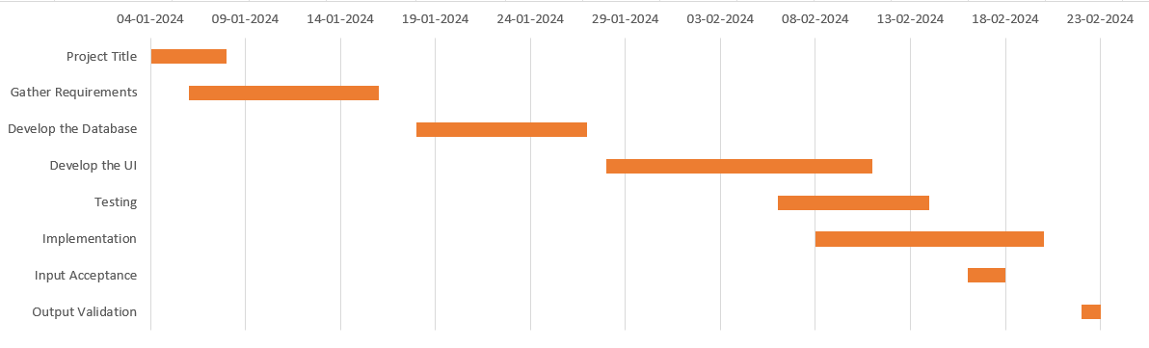
Gantt Chart:

Slide 9
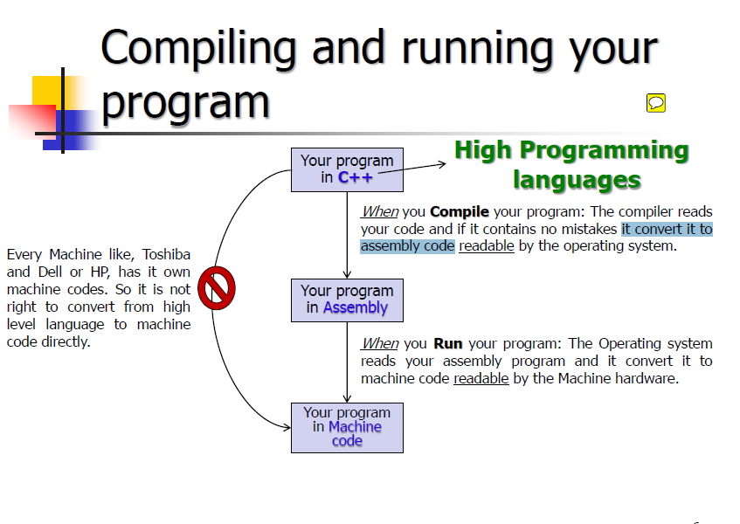
Flow Chart….
.

Slide 10
Literature survey:
An examination of current literature highlights efforts to enhance compiler support for advanced language features in concurrent programming.
Previous research explores optimization techniques, intermediate representations, and register allocation strategies specific to concurrent language constructs.
Inherent limitations persist, resulting in trade-offs between compilation time and code optimization, along with challenges in exploiting hardware resources.
Compromises between compilation time and code optimization are identified, and challenges in exploiting hardware resources pose persistent issues.
Recent advancements emphasize the critical need for innovative approaches to address these challenges and enhance compiler efficiency for concurrent programming languages.
The critical exploration of innovative approaches is essential to overcome limitations and improve the effectiveness of compilers designed for concurrent programming languages.

Slide 11
Resources…….
Here's a brief outline of resources:
Concurrency Models: Study different concurrency models such as shared memory, message passing, actor-based, etc.…
Resources: Research papers, and textbooks on concurrency theory.
Concurrency Control and Synchronization: Learn about mechanisms for managing concurrency, such as locks, semaphores, and transactional memory.
Resources: Operating systems textbooks, concurrency control literature.
Testing and Debugging: Investigate methodologies for testing and debugging concurrent programs.
Resources: Testing and debugging literature, research papers on concurrent debugging tools.
Performance Evaluation: Explore techniques for evaluating the performance of concurrent programs and compilers.
Resources: Performance evaluation methodologies, research papers on benchmarking concurrent systems.

Slide 12
Purpose of this project:
The purpose of building a compiler for a concurrent programming language could be to facilitate the creation of software that can efficiently utilize multiple processors or cores, thereby improving the performance and scalability of the applications.
Additionally, it could enable developers to write concurrent code more easily, by providing abstractions and tools specific to concurrency.
This compiler will translate high-level source code written in the concurrent language into executable machine code or bytecode that can be run on a computer or virtual machine.

Slide 13
Sample Input…
Sample Output….
Simple Arithmetic Expression
input code = "2 + 3 * (4 - 1)"
input code = "(3 + 4) * 5"
Expression with Variables
input code = "a * (b + 2)"
Complex Expression with Parentheses
input code = "(3 + 4) * 5 - (2 / 1)"
Tokens: [('INT', '2'), ('WHITESPACE', ' '), ('PLUS', '+'), ('WHITESPACE', ' '), ('INT', '3'), ('WHITESPACE', ' '), ('MULTIPLY', '*'), ('WHITESPACE', ' '), ('LPAREN', '('), ('INT', '4'), ('WHITESPACE', ' '), ('MINUS', '-'), ('WHITESPACE', ' '), ('INT', '1'), ('RPAREN', ')')]
AST: [('NUM', 2), 'PLUS', ('NUM', 3), 'MULTIPLY', [('NUM', 4), 'MINUS', ('NUM', 1)]]

Slide 14
Conclusion…..
In conclusion, building a compiler for a concurrent programming language serves as a pivotal step toward empowering developers to harness the potential of parallelism and concurrency in software development
By providing a dedicated toolchain for translating high-level concurrent code into executable form, the compiler facilitates the creation of applications that can efficiently utilize multiple processors or cores.
empowering developers to unlock the full potential of modern computing architectures and ushering in a new era of concurrency-driven innovation.
It emphasizes the significance of ongoing innovation in compiler design to effectively address the evolving demands posed by the intricate nature of concurrent programming languages in the context of modern software development.

Slide 15


